Slide 1
A+ TEAM – GO Final project
HARSH
MOHAMMED ABDUL AKRAM KHAN
MOHAMAD MAHDI ZIAEE
MUKHASIR SHAH SYED

Slide 2
Above the fold
Basic idea of above the fold has been derived from the concept where the most important details are displayed on the front side of a newspaper.
In web design, “above the fold” refers to the portion of the webpage that is visible without scrolling.
This type website building has been the trend right now with people being impatient want information in one sight, so “above the fold” designs are in demand.

Slide 3
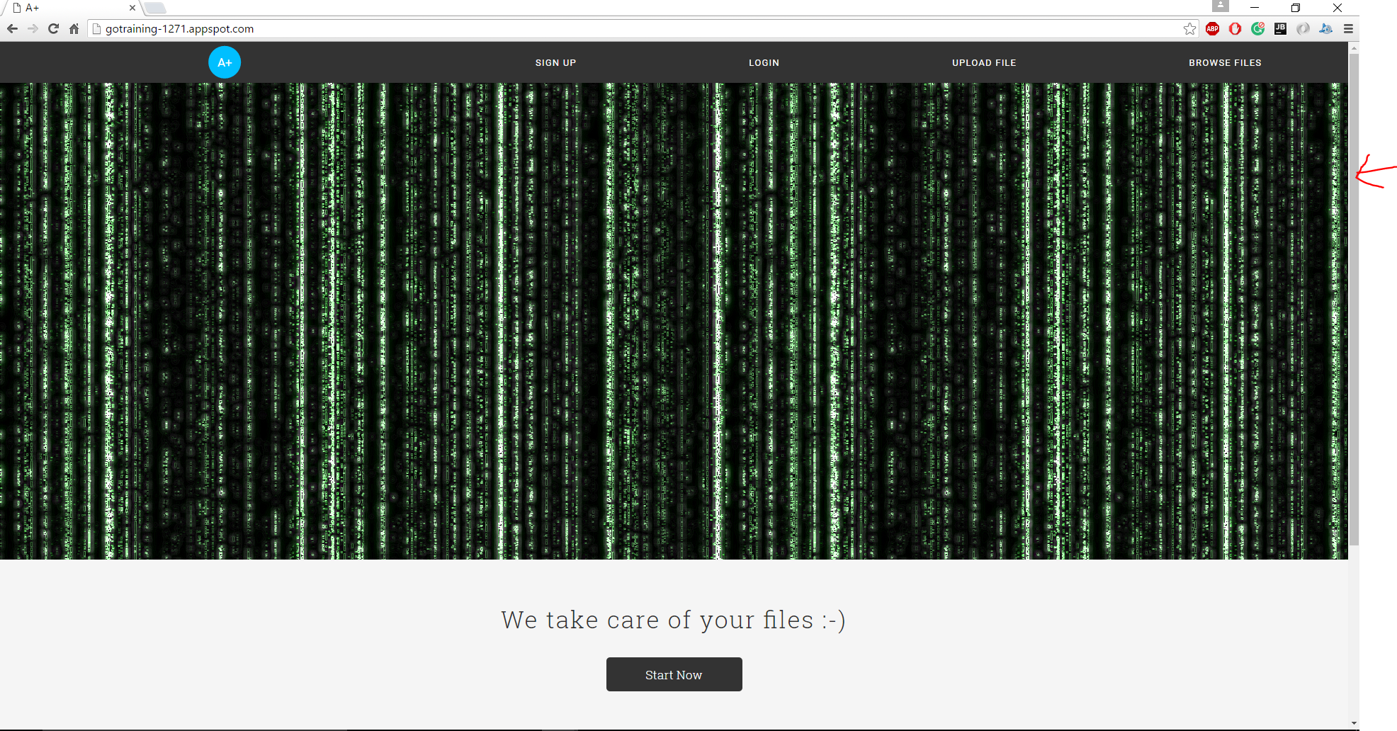
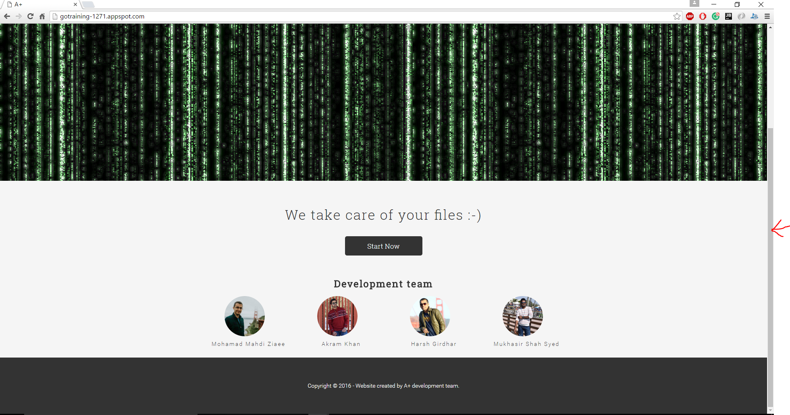
SCREENSHOTS - above the fold

Slide 4
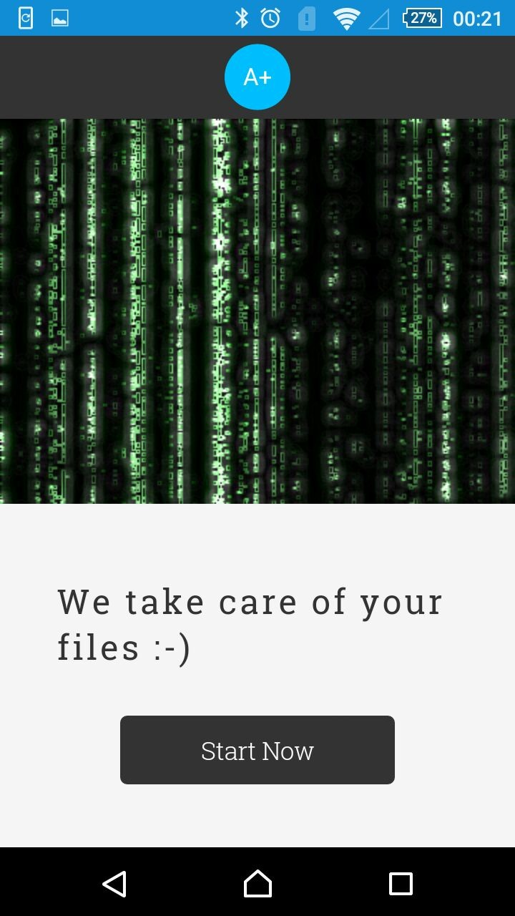


SCREENSHOTS - above the fold – MOBILE
D

Slide 5
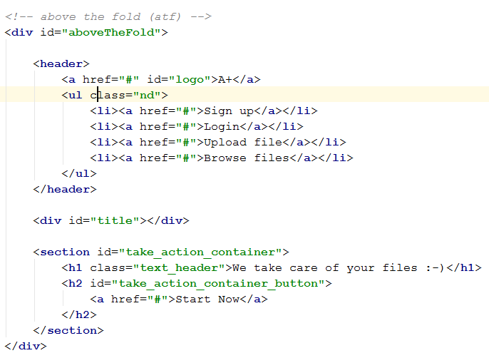
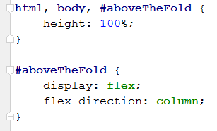
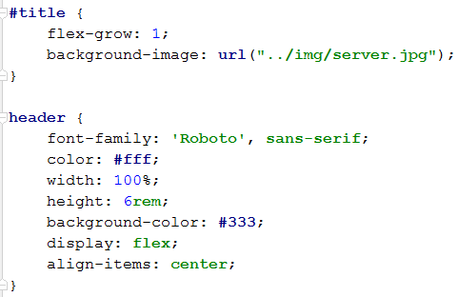
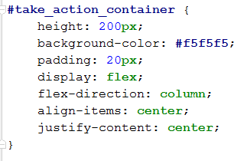
CODE BLOCK – above the fold [ HTML, CSS ]

Slide 6
FLEX BOX
The main idea behind the flex layout is to give the container the ability to alter its items' width/height (and order) to best fill the available space (mostly to accommodate to all kind of display devices and screen sizes). A flex container expands items to fill available free space, or shrinks them to prevent overflow.
The flexbox layout is direction-agnostic as opposed to the regular layouts (block which is vertically-based and inline which is horizontally-based).
Reference : https://css-tricks.com/snippets/css/a-guide-to-flexbox/

Slide 7
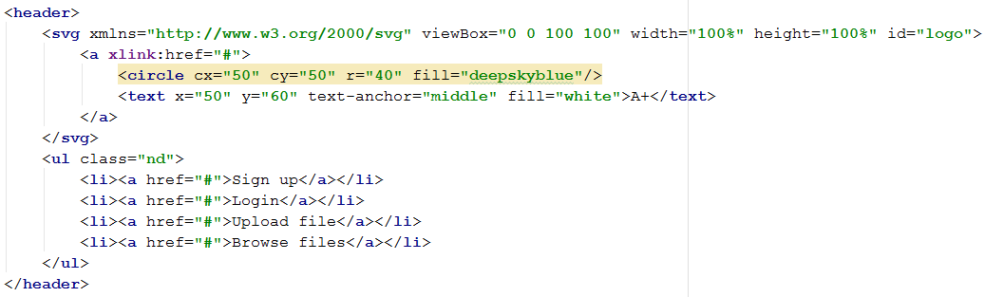
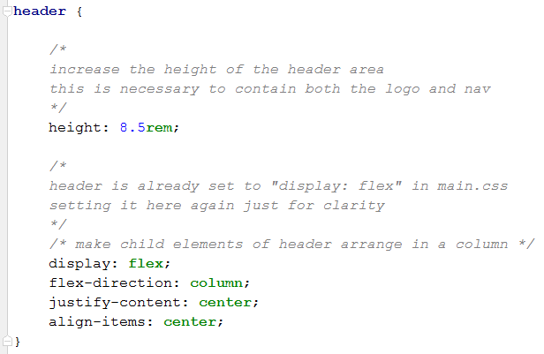
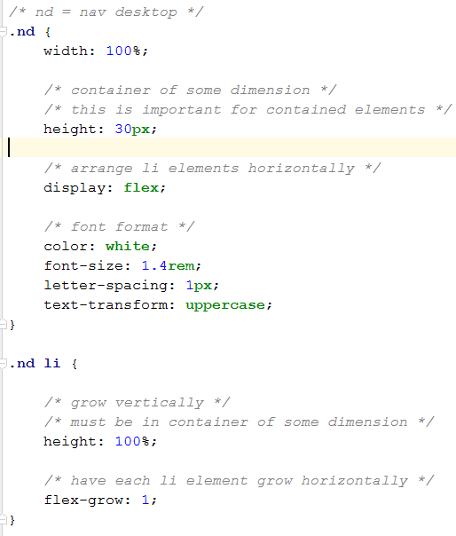
CODE BLOCK – FLEX BOX – MENU

Slide 8
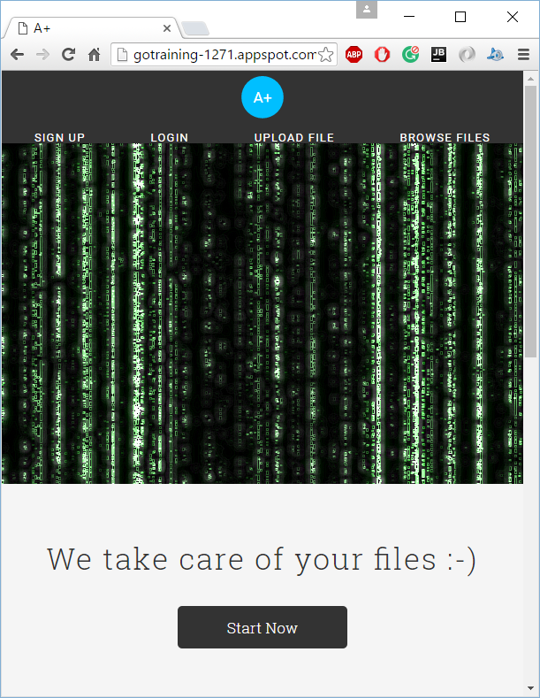
SCREEN SHOT for MENU - >600PX

Slide 9
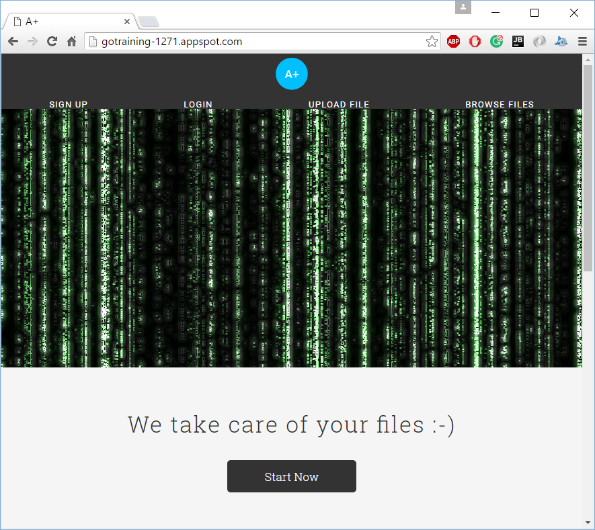
SCREEN SHOTS FOR MENU >600 & <900
D
d

Slide 10
MEDIA queries
A media query consists of a media type and at least one expression that limits the style sheets' scope by using media features, such as width, height, and color. Media queries, added in CSS3, let the presentation of content be tailored to a specific range of output devices without having to change the content itself.
Reference : https://developer.mozilla.org/en-US/docs/Web/CSS/Media_Queries/Using_media_queries
CODE BLOCK – MEDIA QUERIES

Slide 11
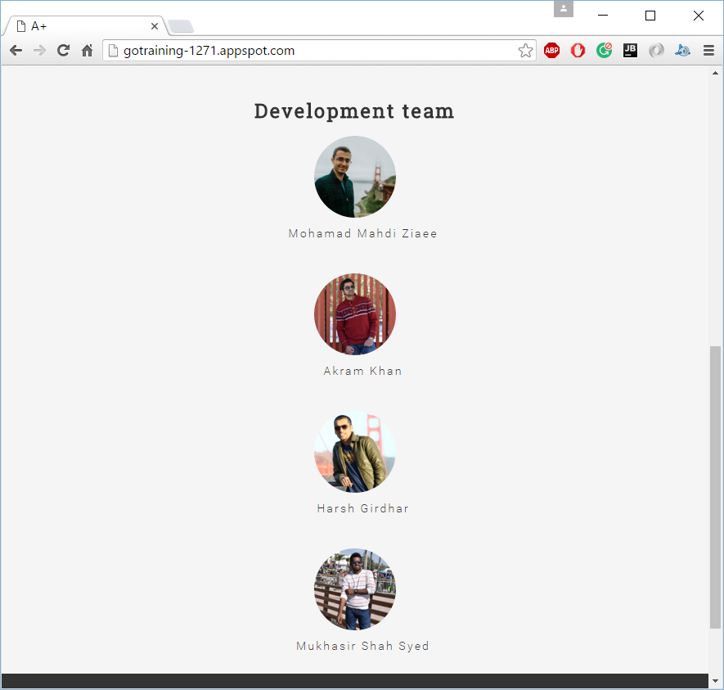
SCREEN SHOT – MEDIA QUERIES >600px and <900px

Slide 12
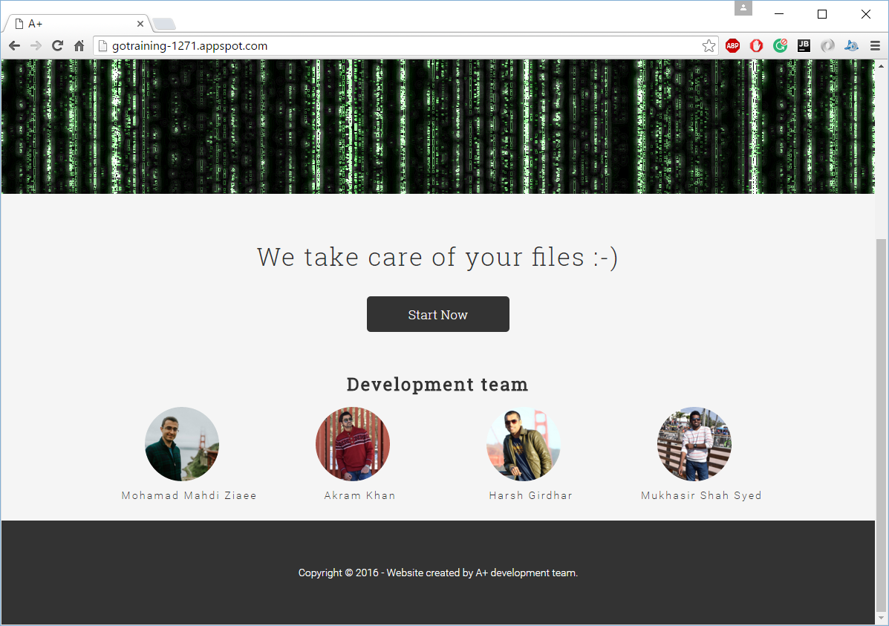
SCREEN SHOT – MEDIA QUERIES “>900px”

Slide 13
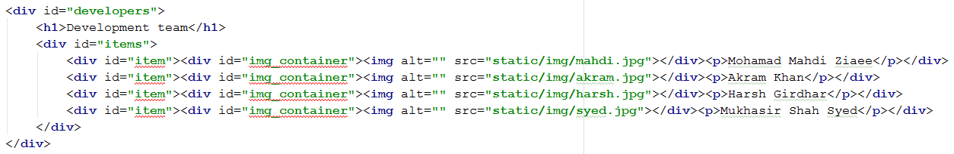
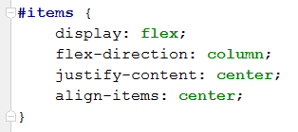
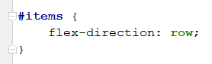
CODE BLOCK – HTML, CSS
Set css styling for mobile view
In Desktop browser view
css styling - >900px
It remains same in tab view - >600px

Slide 14
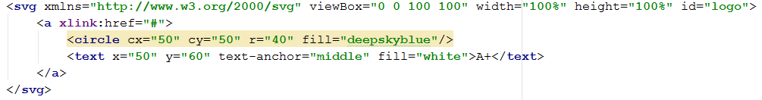
SVG
Scalable Vector Graphics (SVG) is an XML-based vector image format for two-dimensional graphics with support for interactivity and animation. The SVG specification is an open standard developed by the World Wide Web Consortium (W3C) since 1999.
CODE BLOCK USED IN THE WEBPAGE

Slide 15
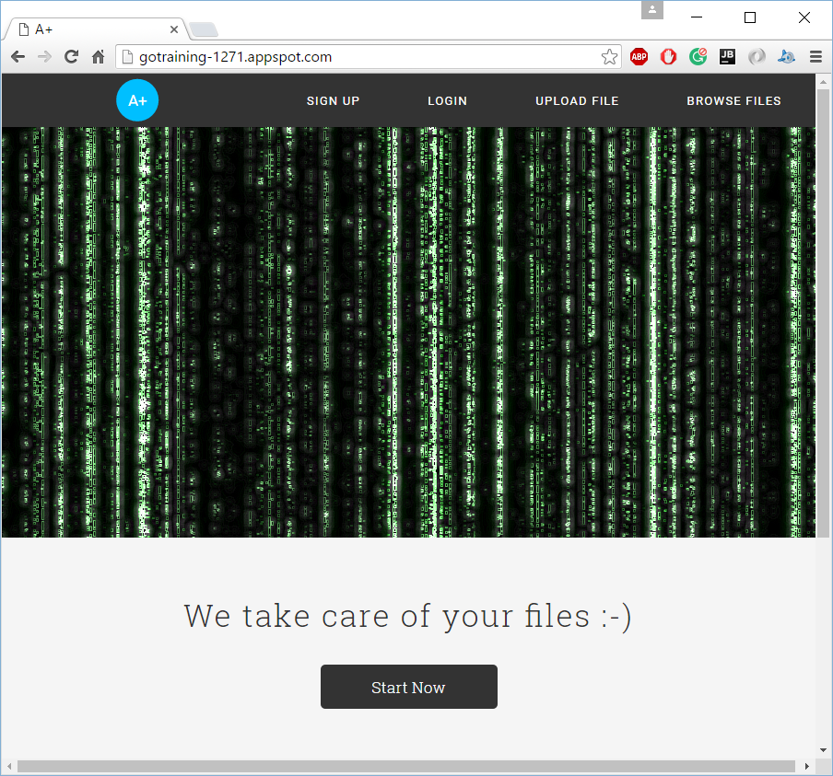
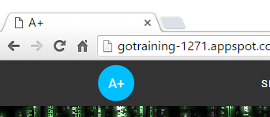
SCREEN SHOT

Slide 16

QUESTIONS

Slide 17

THANK YOU

